Slide 1
INVESTMENT CASE STUDY SUBMISSION
Murali Kummitha

Slide 2
Finding Suitable Investment
Help Spark Funds to find the right place to invest money, Spark Funds has two minor constraints for investments:
It wants to invest between 5 to 15 million USD per round of investment
It wants to invest only in English-speaking countries because of the ease of communication with the companies it would invest

Slide 3
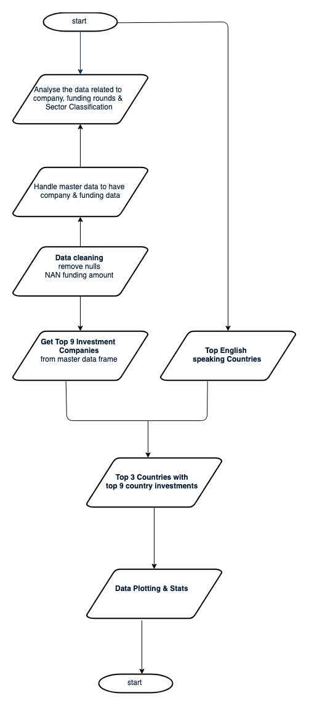
Flowchart

Slide 4
Data cleaning Analysis
There are 2832 rows which with most of the column values are null - have removed those
Remove rows where funding amount is empty - That is basic analysis we are doing and can’t have any assuptions related to investment.
Fetched top english speaking countries from https://en.wikipedia.org/wiki/List_of_countries_by_English-speaking_population and their country codes form CSV file.
Mappings csv if there “0” in the page replaced with “na” in proper places for more meaningful data.
Ex: A0lytics is replaced with Analytics

Slide 5
Data cleaning Analysis
Assumption: if there is master category NOT found in the first level then taking 2nd level.
Ex: if there is a category in master frame with name “Self Development|Social Network Media”
there is no category with name Self Development in the mappings csv
so taking the next category from the pipe operation “|” that is Social Network Media
Master category will become Social Network Media

Slide 6
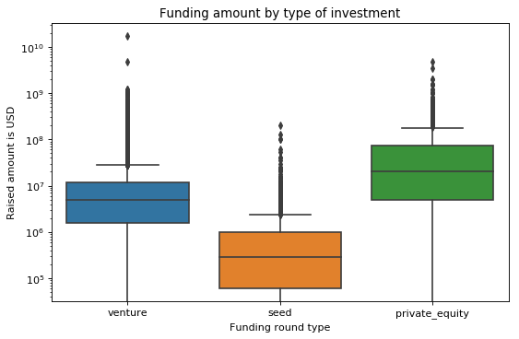
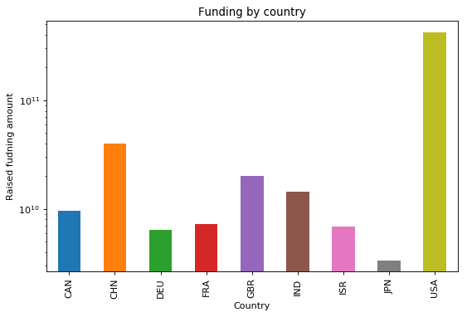
Funding amount by investment type/country

Slide 7
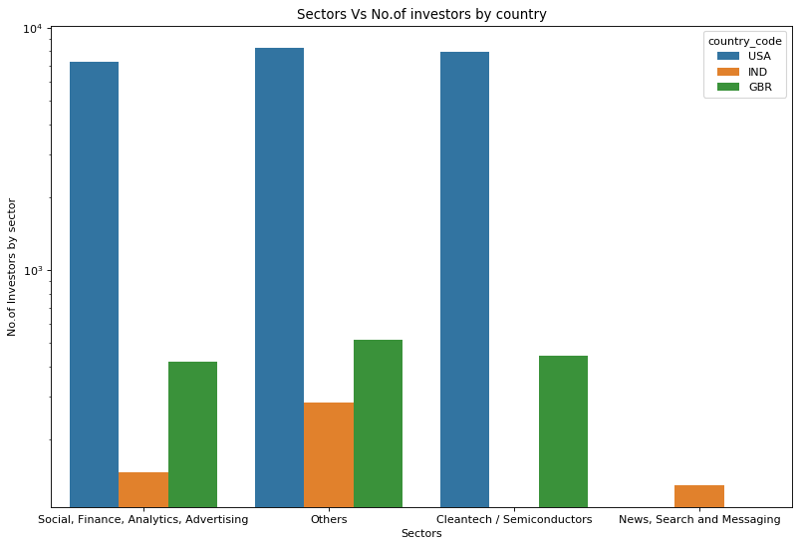
No.of investors by sector for each
country
Above 3 graphs suggesting that Spark with an investment in the range of 5M to 15M:
Venture capitals will suit best with the range of investment
US/India/UK(GBR) are the best suited in terms of no.of english speakers
4 wide range of sectors which can be invested

Slide 8
Conclusions
Spark Funds with an investment in the range of 5M to 15M:
Venture capitals will suit best with in the range of investment
US/India/UK(GBR) are the best suited countries for investment
4 wide range of sectors which can be invested by Spark Funds

